Slide 1

DATABASE SYSTEM
FOR
SEATTLE CAST
A Podcast Network in Seattle
Haery Lee & Jillian Pflugrath Bass & Sakshi Madan
CPSC 5910 02 | March 2020
01

Slide 2

Challenges
03
Creating consistent revenue streams
Signing deals with sponsors that pay cost per Acquisition (CPA)
Each podcast have three ad slots
pre-roll (before episode content)
mid-roll(in the middle of episode content)
post-roll (after episode content).
Need for analytics
Number of downloads and subscriptions
Average rating per podcast
02

Slide 3

Our Mission
To design a database system for Seattle Cast
Attract more lucrative advertising campaigns
Efficiently aggregate download data
Fill up empty ad spots for podcasts
Improve existing analytic strategies
Better business decisions for their audiences
03

Slide 4

How we overcame the challenges
04

Slide 5
Our ER Diagram
Aggregated Fact Table: Summary of rating and number of clicks on ads by a customer for a particular episode of a particular podcast.
05

Slide 6
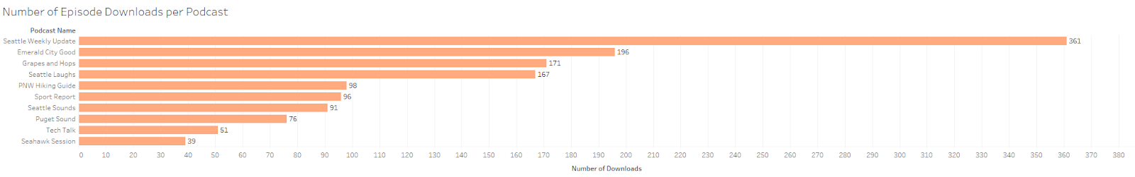
Visualization on Number of Episode Downloads per Podcast
Following is the link to access our Tableau Public site:
https://public.tableau.com/views/PodcastVisualizations/PocastMetrics?:display_count=y&publish=yes&:origin=viz_share_link
06

Slide 7
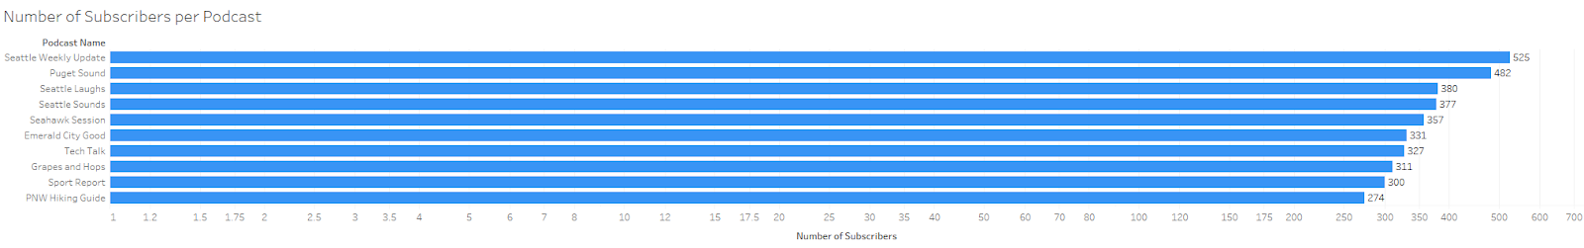
Visualization on Number of Subscribers per Podcast
Following is the link to access our Tableau Public site:
https://public.tableau.com/views/PodcastVisualizations/PocastMetrics?:display_count=y&publish=yes&:origin=viz_share_link
07

Slide 8
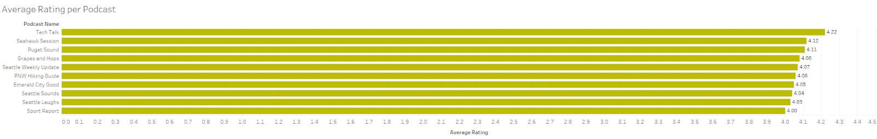
Visualization on Average Rating per Podcast
Following is the link to access our Tableau Public site:
https://public.tableau.com/views/PodcastVisualizations/PocastMetrics?:display_count=y&publish=yes&:origin=viz_share_link
08

Slide 9

Thank you
Contact Us
leeh27@seattleu.edu
pflugrathbaj@seattleu.edu
smadan@seattleu.edu
Team 06 | Winter 2020
09

